Slide 1
360˚ Vision Sensors for Land Vehicles
UNCLASSIFIED
What can VR technology bring to modern Land Vehicles?
Notes:
One of the research areas within Advanced Vehicle Systems is into the improvement of vehicle sensors. To this end, we have been focusing on emergent technologies such as 360 degree video and Virtual Reality as potential additions to our Land Vehicles.
So, what can 360 degree video and VR bring to our next generation land vehicles?

Slide 2
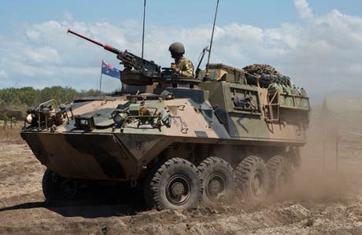
Situational Awareness vs Safety
UNCLASSIFIED
Current trade-off:
Awareness
Safety
Situational Awareness: The perception of events in the environment and the ability to predict their future states
Notes:
To answer that, we need to understand the value of situational awareness and safety.
When on deployment, situational awareness is what keeps our soldiers alive. Being able to accurately assess a situation, identify potential threats in the environment, and act appropriately. This capability is vital as without it, the lives of our servicemen and women are put at risk.
This becomes a problem when awareness is limited in order to provide adequate protection. For example, the M113 Armoured Personnel Carrier is often operated with hatches open to allow operators a greater field of view. This exposes the personnel to enemy fire. In dangerous situations, the hatches go down, and the vehicle is then operated using a restricted field of view using external cameras or view ports. In this scenario, the vehicle now is less capable of making tactical decisions, reducing its effectiveness on deployment.

Slide 3
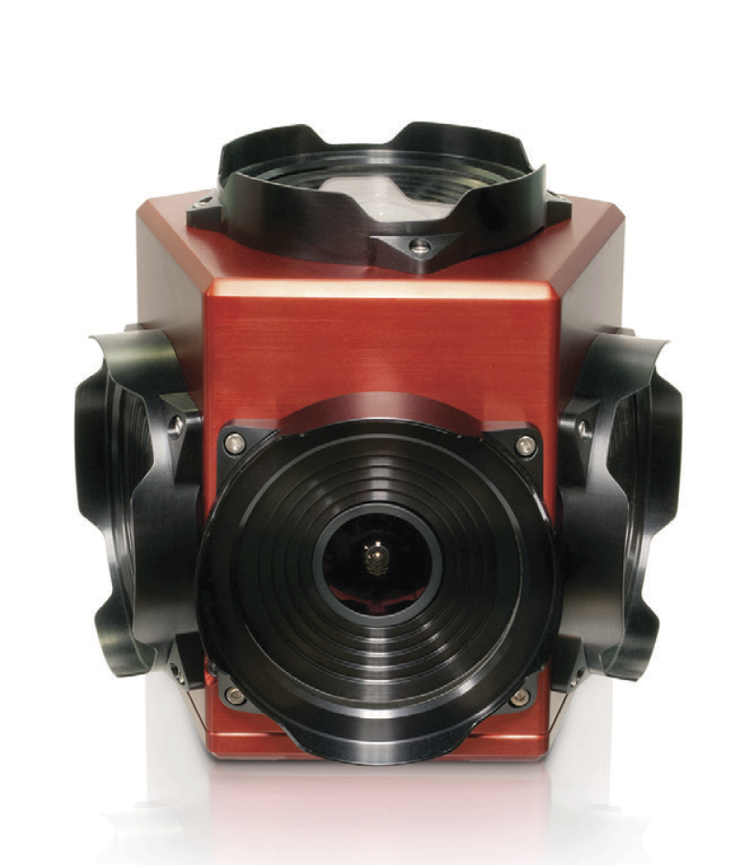

How can 360° Cameras Help?
UNCLASSIFIED
Provides video of all surroundings
Imitates field of view operator would have outside the vehicle
Notes:
A solution to this problem is the use of a 360 degree camera system. This uses an array of wide angle cameras on a single device to record footage from any direction. These images can then be stitched together to make a panoramic view of the camera’s surroundings.
While technically providing vision to all points around the vehicle, this is somewhat difficult to utilise this video as a 2 dimensional image. The image is warped due to the panoramic view and it is sometimes difficult to get accurate information about the environment quickly and easily.

Slide 4
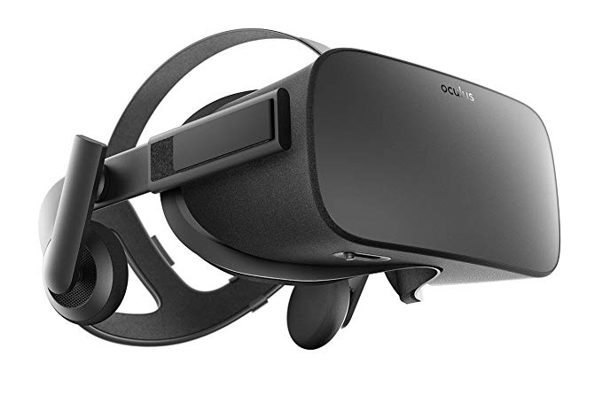
VR Headsets
UNCLASSIFIED
Makes panoramic image from the camera usable
Provides next best alternative to actually being outside the vehicle
Notes:
This is where a Virtual Reality headset, such as the Oculus Rift comes in.
Combined with a VR headset, the 360 degree camera allows operators the same field of view as if they were outside the vehicle. The panorama from before can be viewed in a much more immersive and intuitive manner, which therefore allows personnel to focus on completing other tasks effectively.
With this capability, personnel now have near equivalent situational awareness from within the vehicle, without compromising the safety of the operators. This could be useful for a range of vehicles as a way to increase combat effectiveness in situations where operators need to remain inside the vehicle.

Slide 5
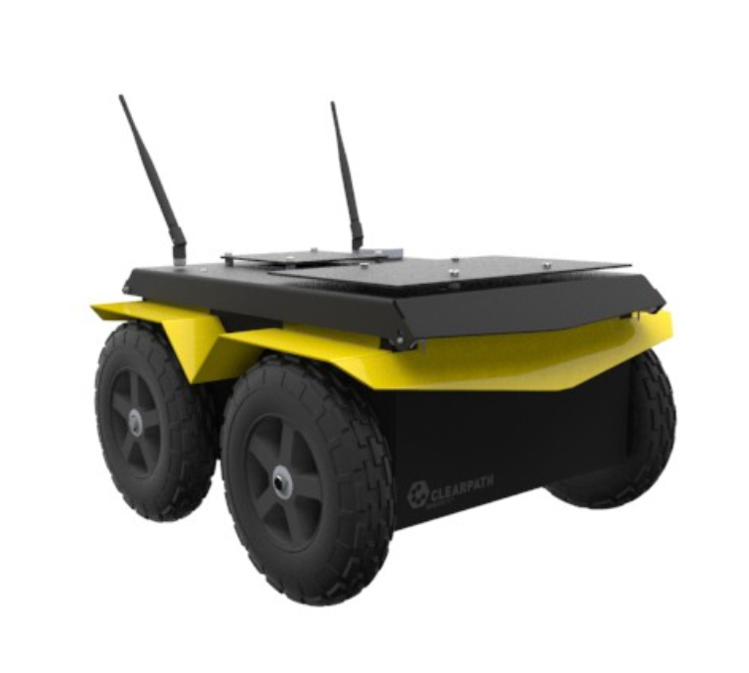
Implementation
UNCLASSIFIED
Clearpath Jackal UGV
Ladybug 5+ 360° Camera
Notes:
For this project, we wanted to implement a basic version of this technology using a Jackal UGV as a testing platform. The aim was to install a 360 degree camera onboard the robot and stream the video to another PC. This involved developing a C++ application to control the camera from the Jackal’s onboard computer.
It also was required to integrate with the Live Stream Oculus HMD project being completed by Harvey, which required a connection to a custom UDP server to transfer image data.

Slide 6
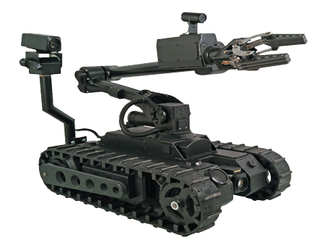
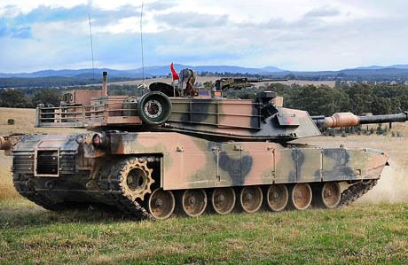
Future Applications
UNCLASSIFIED
Possible platforms
Bomb Disposal Robots
Armored vehicles
LOAVES
Integration with battle overlay system
Conclusion here?
Notes:
Should this technology prove viable, its foreseeable that it could be implemented in a number of different places in Land Division. The majority of armoured vehicles could benefit from increased visual capabilities. Likewise remotely operated vehicles such as bomb disposal robots used to neutralize IED’s could also gain from the addition of this capability.
Such technology could also be integrated with existing battle overlay systems to increase operator efficiency even further.

